Slide 1

Mindreading & Joint Action
Mindreading & Joint Action
3. Tracking, Measuring and
Representing Beliefs
butterfillS@ceu.hu
butterfillS@ceu.hu

Slide 2
What could someone represent that would enable her to track, at least within limits, others' perceptions, knowledge states and beliefs including false beliefs?
Notes:
This lecture is about a simple question.
Before I address the question I want first to explain how we have arrived at it, how it follows from the discussion of previous lectures.
It’s actually at least as hard to explain why the question matters as it is to answer it.

Slide 3
What could someone represent that would enable her to track, at least within limits, others' perceptions, knowledge states and beliefs including false beliefs?
the toxicity of potential food items?
Notes:
compare toxicity ... odour

Slide 4
What could someone represent that would enable her to track, at least within limits, others' perceptions, knowledge states and beliefs including false beliefs?
the toxicity of potential food items?
Notes:
To \textit{track} the toxicity of a food item is for your thoughts or actions to nonaccidentally depend in some way on how toxic the food item is.

Slide 5
What could someone represent that would enable her to track, at least within limits, others' perceptions, knowledge states and beliefs including false beliefs?
Notes:
This lecture is about a simple question.
Before I address the question I want first to explain how we have arrived at it, how it follows from the discussion of previous lectures.
It’s actually at least as hard to explain why the question matters as it is to answer it.

Slide 6
1. There are subjects who can pass A-tasks
Notes:
Recall this puzzle from Lecture 1

Slide 7
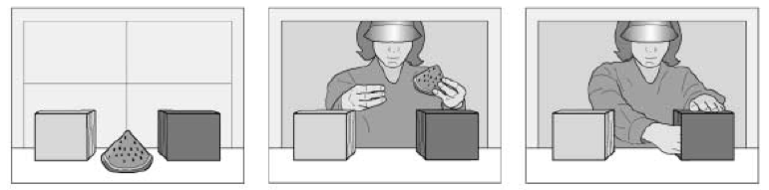
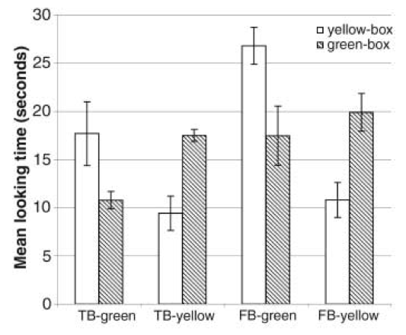
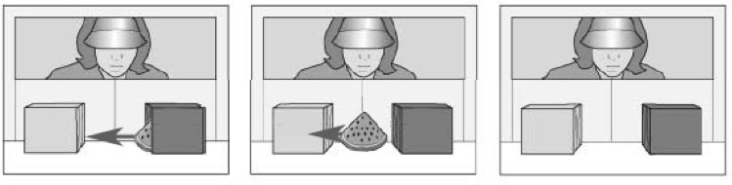
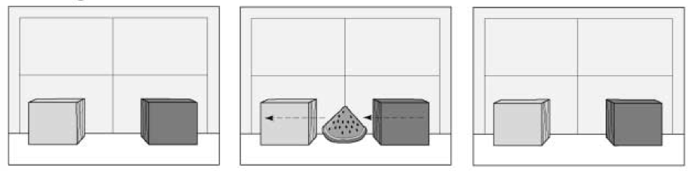
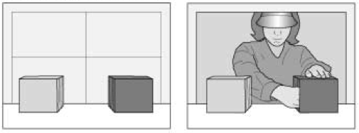
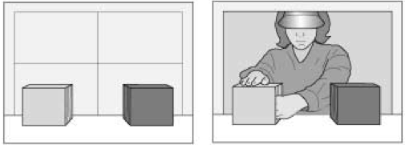
1. There are subjects who can pass A-tasks
Onishi & Baillargeon (2005)
Notes:
A-tasks are defined as those which children can pass from some time around their first birthday, for example Onishi & Baillargeon.
These A-tasks are the tasks that children can pass from sometime around their first birthday or earlier. They deploy a variety of measures, including pointing, helping, comprehending a novel world learning and altercentric interference.

Slide 8
1. There are subjects who can pass A-tasks
2. These subjects’ success on A-tasks is explained by the fact that they can represent (false) beliefs
Notes:
Recall this puzzle from Lecture 1

Slide 9
1. There are subjects who can pass A-tasks but cannot pass B-tasks.
2. These subjects’ success on A-tasks is explained by the fact that they can represent (false) beliefs
Notes:
The B-tasks, by contrast, are defined as tasks that children cannot pass until sometime around their fourth birthday. They are standard false belief tasks where, for instance, Heniz’ chocolate is unexpectedly moved while he is absent and, on his return, children are asked where Heniz will look for his chocolate first.
It is important to the puzzle (i) that for each category for task, A and B, there is a wide variety of methods all of which seem to measure a single competence. And it is also important that success on B-tasks seems to depend on developments in language and executive function, and can be facilitated by training and rich forms of social interaction.

Slide 10
1. There are subjects who can pass A-tasks but cannot pass B-tasks.
2. These subjects’ success on A-tasks is explained by the fact that they can represent (false) beliefs
3. These subjects’ failure on B-tasks is explained by the fact that they cannot represent (false) beliefs
Notes:
This puzzle is related to another one that I didn’t mention yet.

Slide 11
1. There are subjects who can pass A-tasks but cannot pass B-tasks.
2. These subjects’ success on A-tasks is explained by the fact that they can represent (false) beliefs
3. These subjects’ failure on B-tasks is explained by the fact that they cannot represent (false) beliefs
Are human adults’ abilities to represent beliefs automatic?
Notes:
There is a related puzzle about automaticity.
A process is \emph{automatic} if whether it occurs is to a significant degree independent of its relevance to the particulars of the subject's motives and aims.

Slide 12
1. There are subjects who can pass A-tasks but cannot pass B-tasks.
2. These subjects’ success on A-tasks is explained by the fact that they can represent (false) beliefs
3. These subjects’ failure on B-tasks is explained by the fact that they cannot represent (false) beliefs
Are human adults’ abilities to represent beliefs automatic?

Slide 13
1. There are subjects who can pass A-tasks but cannot pass B-tasks.
2. These subjects’ success on A-tasks is explained by the fact that they can represent (false) beliefs
3. These subjects’ failure on B-tasks is explained by the fact that they cannot represent (false) beliefs
Are human adults’ abilities to represent beliefs automatic?
--- yes: Kovács et al (2010), Schneider et al (2011).
Notes:
some evidence says yes ...

Slide 14
1. There are subjects who can pass A-tasks but cannot pass B-tasks.
2. These subjects’ success on A-tasks is explained by the fact that they can represent (false) beliefs
3. These subjects’ failure on B-tasks is explained by the fact that they cannot represent (false) beliefs
Are human adults’ abilities to represent beliefs automatic?
--- yes: Kovács et al (2010), Schneider et al (2011).
--- no: Back & Apperly (2010), Apperly et al (2010).
Notes:
other evidence says no.
And the case for a ‘no’ answer is indirectly supported by evidence that tracking perceptions and beliefs---and even merely holding in mind what another believes, where no inference is required---involves a measurable processing cost \citep{apperly:2008_back,apperly:2010_limits}, consumes attention and working memory in fully competent adults (\citealp{en_1698, lin:2010_reflexively, en_1547} experiments 4-5), may require inhibition \citep{bull:2008_role} and makes demands on executive function \citep{apperly:2004_frontal,samson:2005_seeing}.
These findings, taken together, suggest that tracking others' perceptions and beliefs is sometimes not automatic.

Slide 15
1. There are subjects who can pass A-tasks but cannot pass B-tasks.
2. These subjects’ success on A-tasks is explained by the fact that they can represent (false) beliefs
3. These subjects’ failure on B-tasks is explained by the fact that they cannot represent (false) beliefs
Are human adults’ abilities to represent beliefs automatic?
--- yes: Kovács et al (2010), Schneider et al (2011).
--- no: Back & Apperly (2010), Apperly et al (2010).
Notes:
Anyway, I’m betting that in order to solve the puzzle one of the things we are going to have to do is to task what it is to represent beliefs and other mental states.
And I think there are reasons aside from the puzzle from wanting to do this as well --- I mention the puzzle mainly because it seems to me a way of making the question seem urgent.
In the last lecture I we asked what might be involved in representing beliefs.
I suggested that when someone represents a belief, there are two parameters to specify.

Slide 16
1. There are subjects who can pass A-tasks but cannot pass B-tasks.
2. These subjects’ success on A-tasks is explained by the fact that they can represent (false) beliefs
3. These subjects’ failure on B-tasks is explained by the fact that they cannot represent (false) beliefs
Are human adults’ abilities to represent beliefs automatic?
--- yes: Kovács et al (2010), Schneider et al (2011).
--- no: Back & Apperly (2010), Apperly et al (2010).
Ayesha
Steve
Henry
...
believes
desires
intends
...
Ayesha will cycle up Hármashatár hill
s/he will cycle up Hármashatár hill
Henry will win the lottery
...
that
Subject
Attitude
Content
Notes:
In representing a belief you have to represent a subject, an attitude and a content.

Slide 17
1. There are subjects who can pass A-tasks but cannot pass B-tasks.
2. These subjects’ success on A-tasks is explained by the fact that they can represent (false) beliefs
3. These subjects’ failure on B-tasks is explained by the fact that they cannot represent (false) beliefs
Are human adults’ abilities to represent beliefs automatic?
--- yes: Kovács et al (2010), Schneider et al (2011).
--- no: Back & Apperly (2010), Apperly et al (2010).
Ayesha
Steve
Henry
...
believes
desires
intends
...
Ayesha will cycle up Hármashatár hill
s/he will cycle up Hármashatár hill
Henry will win the lottery
...
that
Subject
Attitude
Content
Notes:
First, you have to specify what sort of abstract objects they are using to distinguish among the contents of beliefs.
This is analogous to specifying what sort of scale someone is using when they represent the temperatures of things.

Slide 18
1. There are subjects who can pass A-tasks but cannot pass B-tasks.
2. These subjects’ success on A-tasks is explained by the fact that they can represent (false) beliefs
3. These subjects’ failure on B-tasks is explained by the fact that they cannot represent (false) beliefs
Are human adults’ abilities to represent beliefs automatic?
--- yes: Kovács et al (2010), Schneider et al (2011).
--- no: Back & Apperly (2010), Apperly et al (2010).
Ayesha
Steve
Henry
...
believes
desires
intends
...
Ayesha will cycle up Hármashatár hill
s/he will cycle up Hármashatár hill
Henry will win the lottery
...
that
Subject
Attitude
Content
Notes:
Second, you have to specify what sort of model they are using of the attitudes.
This is analogous to specifying what sort of model someone is using when they represent mass or force---they might be thinking about these things in terms of the roles they have classical or quantum theories for example, or in some other way.
Last week I tried to suggest there are simpler and more complex models of the attitudes.
I wanted us to focus on decision theory as a model of belief and desire and how they might interact to produce actions because this is such a well-studied model, and one that seems to be realised by a wide range of structures from large organizations to parts of human motor control.
I didn’t mean to suggest that there are stronger reasons for being interested in decision theory, however.
The key thought from last week was just this.
An engineer doesn’t particularly care about the accuracy of the physical models that she uses.
She only cares that they are accurate enough for her purposes.
Further, she often faces a trade-off between accuracy and efficiency.
Using the most accurate models might demand too much in the way of limited resources.
And so she will trade accuracy for efficiency.
Further, she might made different trade-offs in different projects.
For one project she might use a less accurate model, for another project she might know that it’s worth using a more accurate model.
And, finally, which models she can use might depend on her experience and training.
I want to suggest that it is possible in principle to think of mindreaders as like engineers.
We have more and less accurate models of the attitudes.
For example, decision theory captures something about mental states but not everything: it is an approximation that can be implemented without incurring great costs.
And we might use more and less accurate models on different occasions.

Slide 19
1. There are subjects who can pass A-tasks but cannot pass B-tasks.
2. These subjects’ success on A-tasks is explained by the fact that they can represent (false) beliefs
3. These subjects’ failure on B-tasks is explained by the fact that they cannot represent (false) beliefs
Are human adults’ abilities to represent beliefs automatic?
--- yes: Kovács et al (2010), Schneider et al (2011).
--- no: Back & Apperly (2010), Apperly et al (2010).
Ayesha
Steve
Henry
...
believes
desires
intends
...
Ayesha will cycle up Hármashatár hill
s/he will cycle up Hármashatár hill
Henry will win the lottery
...
that
Subject
Attitude
Content
Notes:
So with respect to the first puzzle we might avoid contradiction like this ...

Slide 20
1. There are subjects who can pass A-tasks but cannot pass B-tasks.
2. These subjects’ success on A-tasks is explained by the fact that they can represent (false) beliefs
3. These subjects’ failure on B-tasks is explained by the fact that they cannot represent (false) beliefs
using a simple model
using a sophisticated model
Are human adults’ abilities to represent beliefs automatic?
--- yes: Kovács et al (2010), Schneider et al (2011).
--- no: Back & Apperly (2010), Apperly et al (2010).
Ayesha
Steve
Henry
...
believes
desires
intends
...
Ayesha will cycle up Hármashatár hill
s/he will cycle up Hármashatár hill
Henry will win the lottery
...
that
Subject
Attitude
Content
Notes:
So with respect to the first puzzle we might avoid contradiction like this ...

Slide 21
1. There are subjects who can pass A-tasks but cannot pass B-tasks.
2. These subjects’ success on A-tasks is explained by the fact that they can represent (false) beliefs
3. These subjects’ failure on B-tasks is explained by the fact that they cannot represent (false) beliefs
using a simple model
using a sophisticated model
But that ain’t belief
Notes:
Objection ... what someone is representing when they use simple model of the attitudes is not belief but something lesser ... can avoid this by defining tracking mental states

Slide 22
1. There are subjects who can pass A-tasks but cannot pass B-tasks.
2. These subjects’ success on A-tasks is explained by the fact that they can represent (false) beliefs
3. These subjects’ failure on B-tasks is explained by the fact that they cannot represent (false) beliefs
using a simple model
using a sophisticated model
force
But that ain’t belief
temperature
Notes:
So with respect to the first puzzle we might avoid contradiction like this ...

Slide 23
1. There are subjects who can pass A-tasks but cannot pass B-tasks.
2. These subjects’ success on A-tasks is explained by the fact that they can represent (false) beliefs
3. These subjects’ failure on B-tasks is explained by the fact that they cannot represent (false) beliefs
track
using a simple model
track
using a sophisticated model
force
But that ain’t belief
temperature
Notes:
So with respect to the first puzzle we might avoid contradiction like this ...

Slide 24
1. There are subjects who can pass A-tasks but cannot pass B-tasks.
2. These subjects’ success on A-tasks is explained by the fact that they can represent (false) beliefs
3. These subjects’ failure on B-tasks is explained by the fact that they cannot represent (false) beliefs
track
using a simple model
track
using a sophisticated model
Are human adults’ abilities to represent beliefs automatic?
--- yes: Kovács et al (2010), Schneider et al (2011).
--- no: Back & Apperly (2010), Apperly et al (2010).
track
Notes:
And similarly for the second puzzle about automaticity ...
It’s important to stress that neither puzzle can be completely resolved by distinguishing between models of the attitudes ... I propose that this is a necessary step towards resolving the puzzles rather than something that will completely solve them.
For now the point is just that distinguishing models enables us formally to avoid the contradiction.

Slide 25
What could someone represent that would enable her to track, at least within limits, others' perceptions, knowledge states and beliefs including false beliefs?
Notes:
This lecture is about a simple question.
Before I address the question I want first to explain how we have arrived at it, how it follows from the discussion of previous lectures.
It’s actually at least as hard to explain why the question matters as it is to answer it.

Slide 26

Your field = a set of objects related to you by proximity, orientation, lighting and other factors
You encounter an object = it is in your field
You register an object at a location = you most recently encountered the object at that location

Slide 27
Your field = a set of objects related to you by proximity, orientation, lighting and other factors
You encounter an object = it is in your field
You register an object at a location = you most recently encountered the object at that location
proximity
orientation
lighting
barriers
trajectory
Notes:
An agent’s field is a set of objects related to the agent by proximity. The extent of the field depends on things like lighting and the agent’s orientation.

Slide 28
Your field = a set of objects related to you by proximity, orientation, lighting and other factors
You encounter an object = it is in your field
You register an object at a location = you most recently encountered the object at that location
proximity
orientation
lighting
barriers
trajectory
Notes:
To say that an agent is encountering an object just means that it is in her field. The notion of encountering is a proxy for perception: within limits, an agent perceives an object just when she encounters one. But to think about encountering doesn’t require understanding perception. In particular it doesn’t require understanding perceptual modalities, or perspectives or appearances.

Slide 29
Your field = a set of objects related to you by proximity, orientation, lighting and other factors
You encounter an object = it is in your field
You register an object at a location = you most recently encountered the object at that location
Principle 1: one can’t goal-directedly act on an object unless one has encountered it.
Principle 2: correct registration is a condition of successful action.
Principle 3: when an agent performs a goal-directed action and the goal specifies an object, the agent will act as if the object were actually in the location she registers it at.
proximity
orientation
lighting
barriers
trajectory
Notes:
The third principle says that you can only act on a goal involving an object if you have encountered it. So if you know that someone hasn’t encountered an object, you can predict that they won’t look for it.

Slide 30
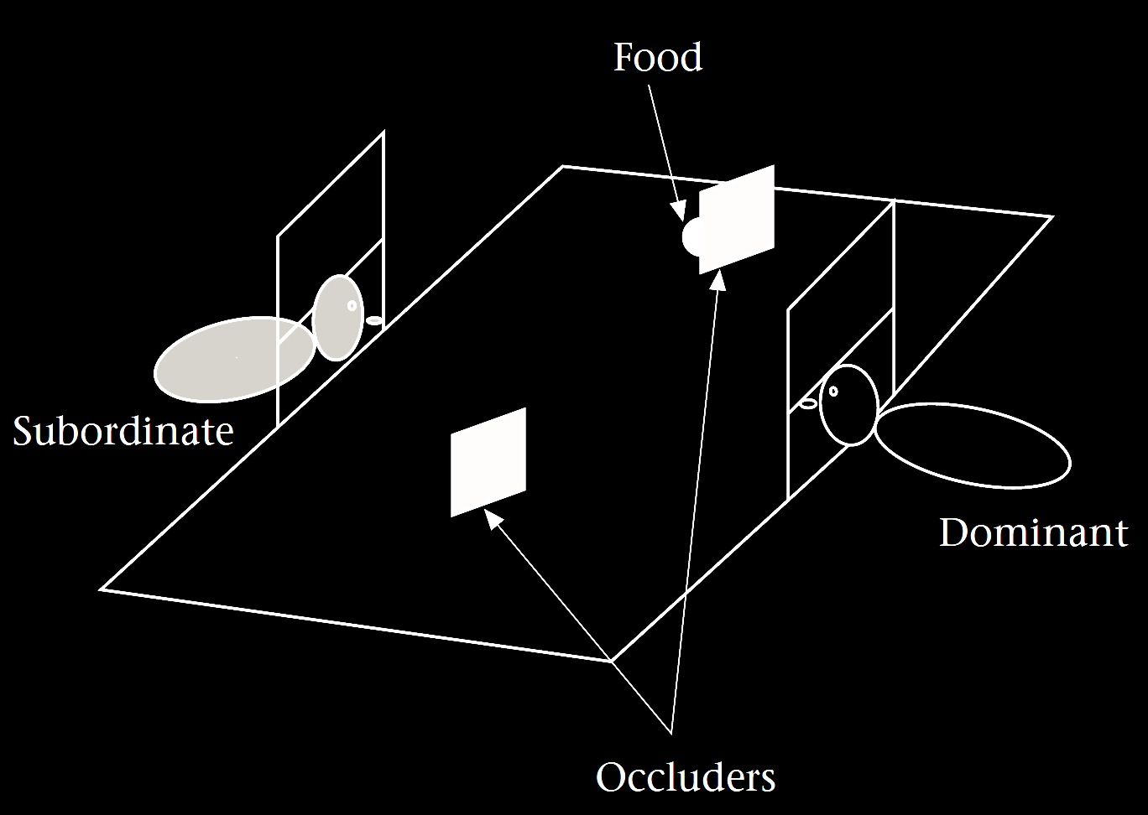
Your field = a set of objects related to you by proximity, orientation, lighting and other factors
You encounter an object = it is in your field
You register an object at a location = you most recently encountered the object at that location
Principle 3: one can’t goal-directedly act on an object unless one has encountered it.
Principle 2: correct registration is a condition of successful action.
Principle 3: when an agent performs a goal-directed action and the goal specifies an object, the agent will act as if the object were actually in the location she registers it at.
proximity
orientation
lighting
barriers
trajectory
Notes:
In this experiment by Brian Hare and colleagues, a subordinate chimpanzee makes predictions about a dominant chimpanzee’s ability to retrieve food. They found that the subordinate’s predictions take into account whether the dominant’s view was blocked while the food was placed. This could be explained by the Third Principle. For the subordinate to predict that the dominant will not be able to recover the food, it is sufficient to think: because the dominant did not encounter the food, she will not be able to retrieve it.

Slide 31
Your field = a set of objects related to you by proximity, orientation, lighting and other factors
You encounter an object = it is in your field
You register an object at a location = you most recently encountered the object at that location
Principle 1: one can’t goal-directedly act on an object unless one has encountered it.
Principle 2: correct registration is a condition of successful action.
Principle 3: when an agent performs a goal-directed action and the goal specifies an object, the agent will act as if the object were actually in the location she registers it at.
proximity
orientation
lighting
barriers
trajectory

Slide 32
Your field = a set of objects related to you by proximity, orientation, lighting and other factors
You encounter an object = it is in your field
You register an object at a location = you most recently encountered the object at that location
Principle 1: one can’t goal-directedly act on an object unless one has encountered it.
Principle 2: correct registration is a condition of successful action.
Principle 3: when an agent performs a goal-directed action and the goal specifies an object, the agent will act as if the object were actually in the location she registers it at.
proximity
orientation
lighting
barriers
trajectory
Notes:
For the next principles we need the notion of registration. This is a relation between agents, objects and locations. An agent registers an object at a location just if she last encountered it there. Registrations can be correct or incorrect. A registration is incorrect when an agent registers an object at a location but it is not at that location.

Slide 33
Your field = a set of objects related to you by proximity, orientation, lighting and other factors
You encounter an object = it is in your field
You register an object at a location = you most recently encountered the object at that location
Principle 1: one can’t goal-directedly act on an object unless one has encountered it.
Principle 2: correct registration is a condition of successful action.
Principle 3: when an agent performs a goal-directed action and the goal specifies an object, the agent will act as if the object were actually in the location she registers it at.
proximity
orientation
lighting
barriers
trajectory
Notes:
Principle Four says that correct registration is a condition of successful action. If you have a goal involving an object, you will only succeed if you register the object at its actual location. To illustrate, suppose you see someone encountering an object which is then moved while they are not watching it. In this situation, Principle Four allows you to predict that they will not be successful in retrieving that object.

Slide 34
Your field = a set of objects related to you by proximity, orientation, lighting and other factors
You encounter an object = it is in your field
You register an object at a location <= you most recently encountered the object at that location
Principle 3: one can’t goal-directedly act on an object unless one has encountered it.
Principle 4: correct registration is a condition of successful action.
Principle 3: when an agent performs a goal-directed action and the goal specifies an object, the agent will act as if the object were actually in the location she registers it at.
proximity
orientation
lighting
barriers
trajectory

Slide 35


“chimpanzees understand … intentions … perception and knowledge … Moreover, they understand how these psychological states work together to produce intentional action”
(Call & Tomasello 2008:191)

Slide 36
“chimpanzees understand … intentions … perception and knowledge … Moreover, they understand how these psychological states work together to produce intentional action”
(Call & Tomasello 2008:191)

Slide 37
Your field = a set of objects related to you by proximity, orientation, lighting and other factors
You encounter an object = it is in your field
You register an object at a location = you most recently encountered the object at that location
Principle 1: one can’t goal-directedly act on an object unless one has encountered it.
Principle 2: correct registration is a condition of successful action.
Principle 3: when an agent performs a goal-directed action and the goal specifies an object, the agent will act as if the object were actually in the location she registers it at.
proximity
orientation
lighting
barriers
trajectory

Slide 38
source: Liszkowski et al (2008)

Slide 39
source: Liszkowski et al (2008)

Slide 40
source: Liszkowski et al (2008)

Slide 41
source: Liszkowski et al (2008)

Slide 42
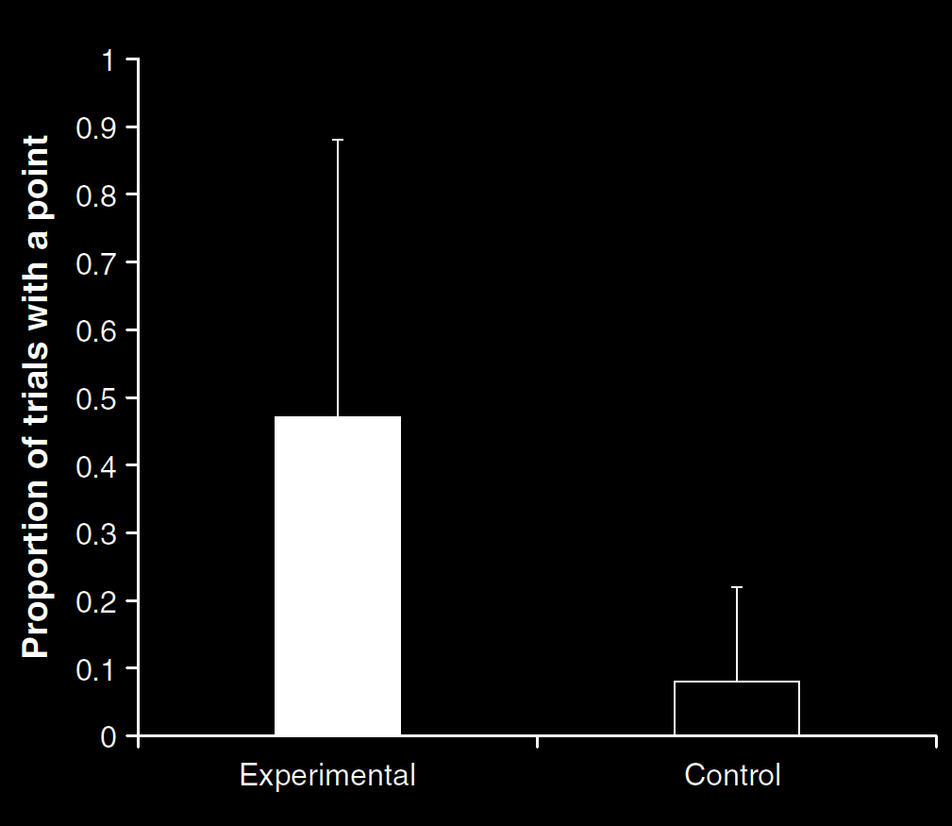
Your field = a set of objects related to you by proximity, orientation, lighting and other factors
You encounter an object = it is in your field
You register an object at a location = you most recently encountered the object at that location
Principle 1: one can’t goal-directedly act on an object unless one has encountered it.
Principle 2: correct registration is a condition of successful action.
Principle 3: when an agent performs a goal-directed action and the goal specifies an object, the agent will act as if the object were actually in the location she registers it at.
source: Liszkowski et al (2008)
proximity
orientation
lighting
barriers
trajectory

Slide 43
Your field = a set of objects related to you by proximity, orientation, lighting and other factors
You encounter an object = it is in your field
You register an object at a location = you most recently encountered the object at that location
Principle 1: one can’t goal-directedly act on an object unless one has encountered it.
Principle 2: correct registration is a condition of successful action.
Principle 3: when an agent performs a goal-directed action and the goal specifies an object, the agent will act as if the object were actually in the location she registers it at.
“Helping by informing inextricably involves … an understanding of others’ goals and … of others’ ignorance.”
(Liszkowski, Carpenter & Tomasello 2008: 738-9)
source: Liszkowski et al (2008)
proximity
orientation
lighting
barriers
trajectory

Slide 44
Your field = a set of objects related to you by proximity, orientation, lighting and other factors
You encounter an object = it is in your field
You register an object at a location = you most recently encountered the object at that location
Principle 1: one can’t goal-directedly act on an object unless one has encountered it.
Principle 2: correct registration is a condition of successful action.
Principle 3: when an agent performs a goal-directed action and the goal specifies an object, the agent will act as if the object were actually in the location she registers it at.
“Helping by informing inextricably involves … an understanding of others’ goals and … of others’ ignorance.”
(Liszkowski, Carpenter & Tomasello 2008: 738-9)
“Helping by informing inextricably involves … an understanding of others’ goals and … of others’ ignorance.”
(Liszkowski, Carpenter & Tomasello 2008: 738-9)
source: Liszkowski et al (2008)
proximity
orientation
lighting
barriers
trajectory

Slide 45
Your field = a set of objects related to you by proximity, orientation, lighting and other factors
You encounter an object = it is in your field
You register an object at a location = you most recently encountered the object at that location
Principle 1: one can’t goal-directedly act on an object unless one has encountered it.
Principle 2: correct registration is a condition of successful action.
Principle 3: when an agent performs a goal-directed action and the goal specifies an object, the agent will act as if the object were actually in the location she registers it at.
proximity
orientation
lighting
barriers
trajectory

Slide 46
Your field = a set of objects related to you by proximity, orientation, lighting and other factors
You encounter an object = it is in your field
You register an object at a location = you most recently encountered the object at that location
Principle 1: one can’t goal-directedly act on an object unless one has encountered it.
Principle 2: correct registration is a condition of successful action.
Principle 3
proximity
orientation
lighting
barriers
trajectory

Slide 47
Your field = a set of objects related to you by proximity, orientation, lighting and other factors
You encounter an object = it is in your field
You register an object at a location = you most recently encountered the object at that location
Principle 1: one can’t goal-directedly act on an object unless one has encountered it.
Principle 2: correct registration is a condition of successful action.
Principle 3: when an agent performs a goal-directed action and the goal specifies an object, the agent will act as if the object were actually in the location she registers it at.
proximity
orientation
lighting
barriers
trajectory
Notes:
Principle Four doesn’t enable you to pass false belief tasks. This is because when people have incorrect registrations, this Principle doesn’t allow you to predict what actions they will perform. To do this you need Principle Five. With this Principle, we move from thinking of registration as a condition on action to thinking of it as a cause of action. Principle Five says that agents will act as if objects were actually at the locations they register them as being. What determines where an agent will look for an object is not its actual location but the location the agent registered it as being at. This Principle is sufficient for passing some false belief tasks.
These five Principles can be extended to explain further theory of mind abilities. I only cover these five in the poster because they are the minimum needed for passing some famous infant false belief tasks.

Slide 48
What could someone represent that would enable her to track, at least within limits, others' perceptions, knowledge states and beliefs including false beliefs?
Notes:
Question was ...
This is a question about possibility in principle.
One answer is: encountering and registration as defined by the three principles.
But the motivation for addressing this question was about infants’ abilities to track mental states.
A further hypothesis is that minimal theory of mind may describe what enables infants’ and others with limited cognitive resources to track beliefs and other mental states.
For this hypothesis to be worth testing, it has to generate predictions that distinguish it from the hypothesis that infants have a full-blown, adult-like conception of belief.
And we need the same for adults: we have to be able to distinguish the hypothesis that in a particular task an adult is using minimal theory of mind ...

Slide 49
1. There are subjects who can pass A-tasks but cannot pass B-tasks.
2. These subjects’ success on A-tasks is explained by the fact that they can represent (false) beliefs
3. These subjects’ failure on B-tasks is explained by the fact that they cannot represent (false) beliefs
track
using a simple model
track
using a sophisticated model
Are human adults’ abilities to represent beliefs automatic?
--- yes: Kovács et al (2010), Schneider et al (2011).
--- no: Back & Apperly (2010), Apperly et al (2010).
track

Slide 50
signature limits

Slide 51
admin
Notes:
(1) who is leading discussion next week;
(2) replace Matthews for second discussion

Slide 52
Tim Bayne (University of Oxford)
"Belief and its bedfellows"
Tuesday, 9 October, 2012, 5.30 PM
Zrinyi 14, Room 412
admin
Notes:
(1) who is leading discussion next week;
(2) replace Matthews for second discussion

Slide 53
signature limits

Slide 54
1. Charly is Samantha
2. Mitch believes that Charly is in Baltimore
3. Mitch believes that Samantha is in Baltimore
(1) & (2) ⇒ (3)

Slide 55
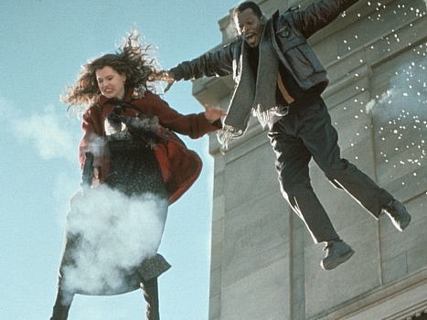
1. Charly is Samantha
2. Mitch believes that Charly is in Baltimore
3. Mitch believes that Samantha is in Baltimore
(1) & (2) ⇒ (3)

Slide 56
1. Charly is Samantha
2. Mitch believes that Charly is in Baltimore
3. Mitch believes that Samantha is in Baltimore
(1) & (2) ⇒ (3)
4. Mitch registers <Charly, Baltimore>
5. Mitch registers <Samantha, Baltimore>
(1) & (4) ⇒ (5)

Slide 57
False belief about location
False belief about identity
Subjects represent registration
Subjects represent beliefs
pass
fail
pass
pass

Slide 58
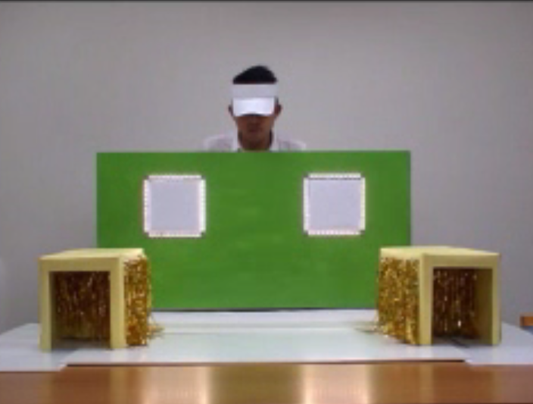
source: Low & Watts (2012)
Notes:
this is the test moment --- where will you look when the lights go on ...

Slide 59
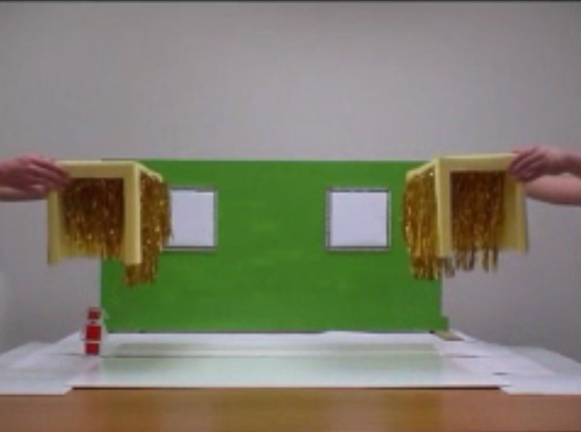
source: Low & Watts (2012)
Notes:
going right back to the start ...

Slide 60
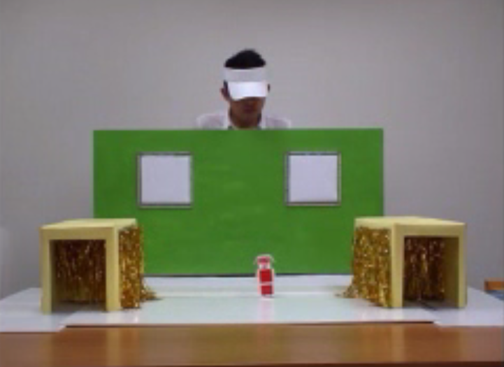
source: Low & Watts (2012)

Slide 61
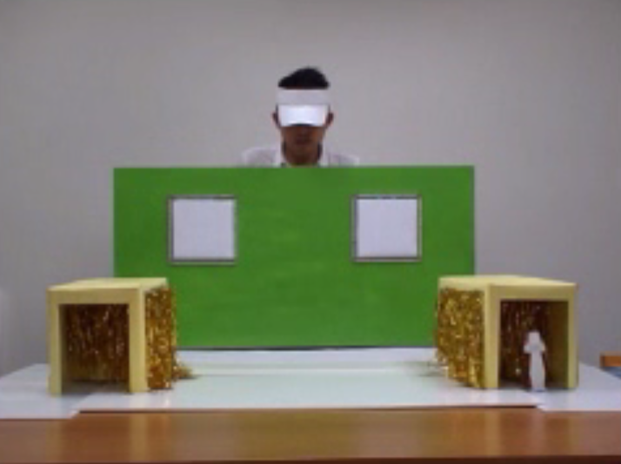
source: Low & Watts (2012)

Slide 62
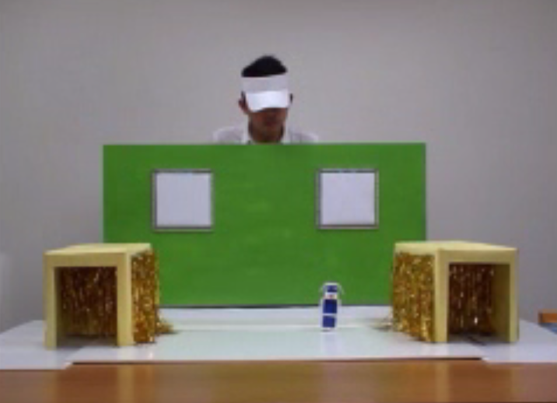
source: Low & Watts (2012)

Slide 63
first look
1
1
.9
.9
proportion correct
location
location
location
3-year-olds
4-year-olds
adults
source: Low & Watts (2012)
Notes:
Although this is my view and I stand by it, I don't think it resolves the puzzle all by itself.
The problem is this.
Success on many B-tasks is in principle possible using only a very simple measure for representing beliefs.
Further, B-tasks do not seem to differ from A-tasks with respect to which measures for representing beliefs could in principle explain success on these tasks.
So the view raises and does not answer the question of why children continue to systematically fail false belief B-tasks years after they can pass A-tasks.

Slide 64
first look
1
1
.9
.9
proportion correct
.25
.06
.06
location
identity
location
identity
location
identity
3-year-olds
4-year-olds
adults
source: Low & Watts (2012)
Notes:
Although this is my view and I stand by it, I don't think it resolves the puzzle all by itself.
The problem is this.
Success on many B-tasks is in principle possible using only a very simple measure for representing beliefs.
Further, B-tasks do not seem to differ from A-tasks with respect to which measures for representing beliefs could in principle explain success on these tasks.
So the view raises and does not answer the question of why children continue to systematically fail false belief B-tasks years after they can pass A-tasks.

Slide 65
first look
direct prediction
1
1
1
.95
.9
.9
.75
.56
proportion correct
.31
.25
.13
.06
.06
location
identity
location
identity
location
identity
3-year-olds
4-year-olds
adults
source: Low & Watts (2012)
Notes:
Although this is my view and I stand by it, I don't think it resolves the puzzle all by itself.
The problem is this.
Success on many B-tasks is in principle possible using only a very simple measure for representing beliefs.
Further, B-tasks do not seem to differ from A-tasks with respect to which measures for representing beliefs could in principle explain success on these tasks.
So the view raises and does not answer the question of why children continue to systematically fail false belief B-tasks years after they can pass A-tasks.

Slide 66
1. There are subjects who can pass A-tasks but cannot pass B-tasks.
2. These subjects’ success on A-tasks is explained by the fact that they can represent (false) beliefs
3. These subjects’ failure on B-tasks is explained by the fact that they cannot represent (false) beliefs
using a simple model
using a sophisticated model
Notes:
to make sense of modular mindreading you need relatively simple measures of belief; and these relatively simple measures need to be constructed; in describing minimal theory of mind we have described a measure of belief which is flexible enough to explain success on a variety of false belief tasks but which could also be implemented efficiently, without placing demands on executive function, working memory and attention. Minimal theory of mind may be what enables those with limited cognitive resources or little cognitive sophistication ... to track others’ beliefs.
This does allow us to avoid contradiction.
But of course this doesn’t solve the puzzle ... after all, minimalToM is enough for standard tasks ...
Next week is modularity

Slide 67
1. There are subjects who can pass A-tasks but cannot pass B-tasks.
2. These subjects’ success on A-tasks is explained by the fact that they can represent (false) beliefs
3. These subjects’ failure on B-tasks is explained by the fact that they cannot represent (false) beliefs
using a simple model
in a modular process
using a sophisticated model
in a non-modular process
Notes:
... next week is modularity.
You might think that if we’re going to appeal to modularity, then why did we need to introduce this stuff about measures ... the answer is to do with constraints on the sorts of process that can be modular.

Slide 68
Notes:
... next week is modularity.
You might think that if we’re going to appeal to modularity, then why did we need to introduce this stuff about measures ... the answer is to do with constraints on the sorts of process that can be modular.

Slide 69
Detour
Goals are not intentions

Slide 70
What is the relation between an action and the goal (or goals) to which it is directed?
out
out
act
out
out

Slide 71
What is the relation between an action and the goal (or goals) to which it is directed?
out
out
act
out
out

Slide 72
What is the relation between an action and the goal (or goals) to which it is directed?
out
out
act
out
intention or other goal-state
out

Slide 73
What is the relation between an action and the goal (or goals) to which it is directed?
teleological function
out
out
act
out
intention or other goal-state
out

Slide 74
(i) in the past, actions of this type have caused outcomes of this type; (ii) this action happens now in part because (i).
What is the relation between an action and the goal (or goals) to which it is directed?
teleological function
out
out
act
out
intention or other goal-state
out

Slide 75
(i) in the past, actions of this type have caused outcomes of this type; (ii) this action happens now in part because (i).
What is the relation between an action and the goal (or goals) to which it is directed?
teleological function
out
out
act
out
intention or other goal-state
It is possible to represent goal-directed actions without representing intentions.
out

Slide 76
X preens me
X sings
X likes me
preen X
Notes:
some birds may benefit from preening others because doing so causes others to like them and thereby strengthens social bonds (Clayton and Emery 2007). In preening they are exercising a theory of mind ability. It doesn’t follow, of course, that preening involves theory of mind cognition. One might be driven to preen others without understanding that preening is worthwhile because it influences others’ attitudes. For example, you might preen because you realise doing so causes others to sing and to preen you back.

Slide 77
X preens me
X sings
X likes me
preen X

Slide 78
X preens me
X sings
X likes me
preen X
Notes:
... They are tracking how much others like them but they are not representing liking as such.
Now in this case tracking involves representing behaviour only.
But it is also possible to track mental states by representing mental states, of course.

Slide 79
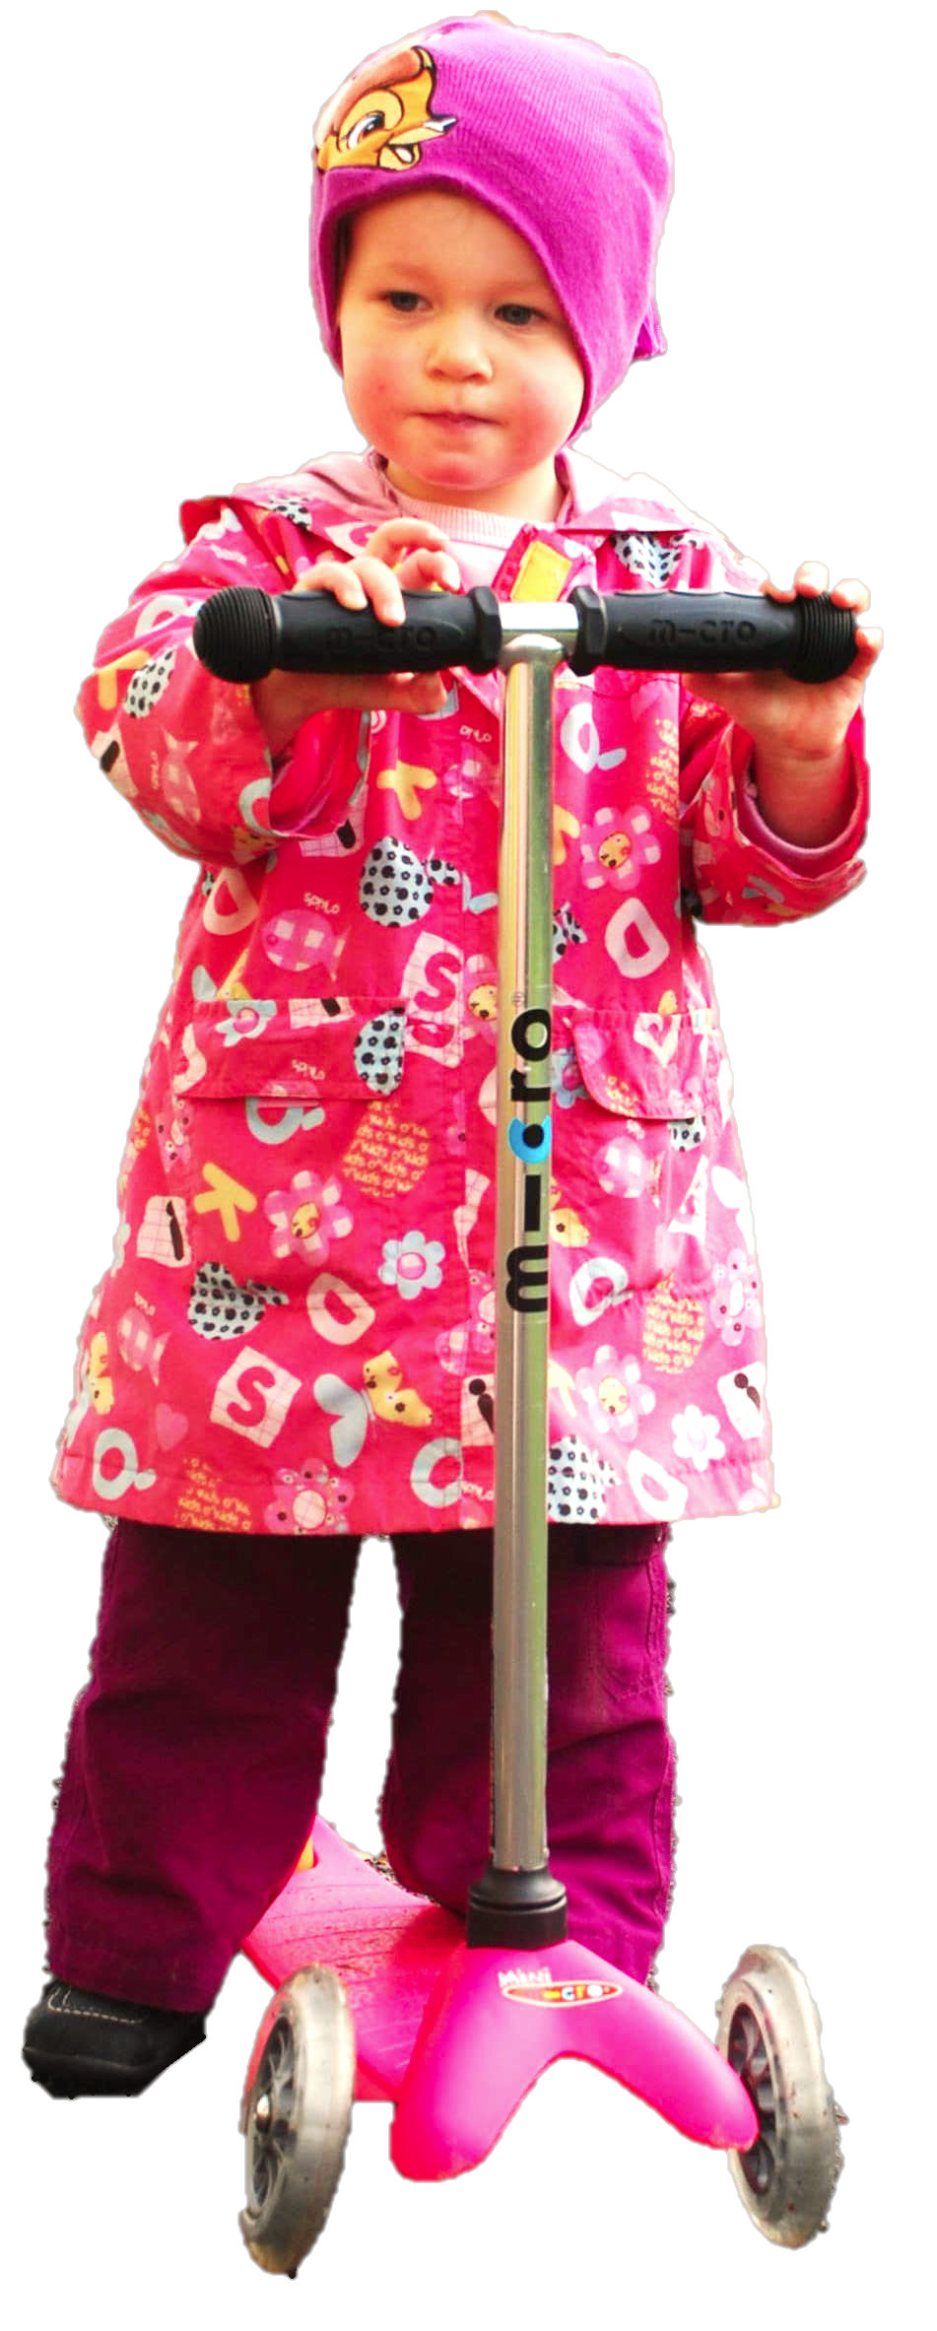
Notes:
Another illustration ... Hannah likes to steal her sister’s things ... but she doesn’t always do this just because she wants to.
Instead she’s able to discern whether another's eyes are in view,
And she only steals when no one’s eyes are in view.
And this benefits her by enabling her to reduce the risk of retribution.
And she does this---only stealing when eyes are not in view---because it brings this benefit.
Then we have this chain:
Hannah steals now (but not earlier) because no one’s eyes are in view.
And she does this because doing so brings benefits.
And it brings benefits because of facts about other’s visual experiences.
So Hannah is tracking other’s perceptual experiences but representing their eyes only.
that Hannah exercises this ability to escape detection while stealing from others,
that Hannah's ability exists in part because it benefits her in this way,
and
that Hannah's escaping detection depends on exploiting a fact about other's mental states (namely that they usually cannot see Hannah's acts of theft when Hannah doesn't have their eyes in view).
Then Hannah has a theory of mind ability.

Slide 80
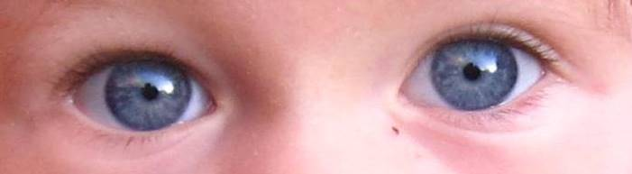

Slide 81
force
But that ain’t belief
temperature
whatever
Notes:
So far: all examples of tracking involved representing no mental states at all. But this is not necessary feature.
Reply to objection is to scale back:
suppose someone has an inaccurate model of the attitudes and uses something other than propositions to distinguish among contents.
we can be neutral on whether someone is representing belief or not
just think about tracking.

Slide 82
Notes:
So far: all examples of tracking involved representing no mental states at all. But this is not necessary feature.
Reply to objection is to scale back:
suppose someone has an inaccurate model of the attitudes and uses something other than propositions to distinguish among contents.
we can be neutral on whether someone is representing belief or not
just think about tracking.

Slide 83
Rubio, Richardson & Butterfill
Notes:
First introduce them to a sequence in three slides ... [large pictures so hopefully everyone can see what’s going on]
These are all from the subject’s point of view.
We’re going to start with what looks almost exactly like the test condition from a standard false belief task.
(1) The observer watches as his car disappears behind a barrier on your [audience’s] left

Slide 84
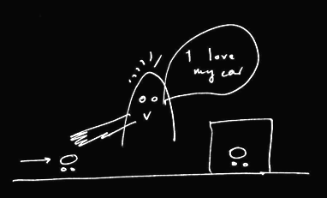
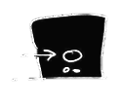
Rubio, Richardson & Butterfill
Notes:
First introduce them to a sequence in three slides ... [large pictures so hopefully everyone can see what’s going on]
These are all from the subject’s point of view.
We’re going to start with what looks almost exactly like the test condition from a standard false belief task.
(1) The observer watches as his car disappears behind a barrier on your [audience’s] left

Slide 85
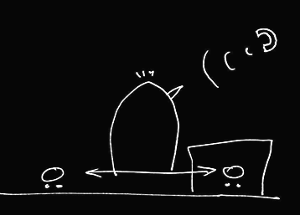

Rubio, Richardson & Butterfill
Notes:
(2) a telephone rings and the observer is distracted ... meanwhile the cars silently swap places (they’re electric cars, natch).

Slide 86
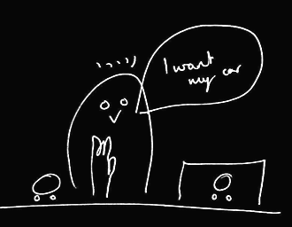
Rubio, Richardson & Butterfill
Notes:
(3) the observer comes back and wants to get her car (note the raised hand). Where do subjects look? They know that the observer’s car is actually behind the barrier. They are also in a position to know that the observer might not know this and might mistakenly think that his car is the one on subject’s LEFT.

Slide 87
her car is here
Rubio, Richardson & Butterfill
Notes:
(3) the observer comes back and wants to get her car (note the raised hand). Where do subjects look? They know that the observer’s car is actually behind the barrier. They are also in a position to know that the observer might not know this and might mistakenly think that his car is the one on subject’s LEFT.

Slide 88
she believes her car is here
her car is here
Rubio, Richardson & Butterfill
Notes:
(3) the observer comes back and wants to get her car (note the raised hand). Where do subjects look? They know that the observer’s car is actually behind the barrier. They are also in a position to know that the observer might not know this and might mistakenly think that his car is the one on subject’s LEFT.

Slide 89
she believes her car is here
her car is here
Rubio, Richardson & Butterfill
Notes:
(3) the observer comes back and wants to get her car (note the raised hand). Where do subjects look? They know that the observer’s car is actually behind the barrier. They are also in a position to know that the observer might not know this and might mistakenly think that his car is the one on subject’s LEFT.

Slide 90
we predict Ss will look here
she believes her car is here
her car is here
Rubio, Richardson & Butterfill
Notes:
(3) the observer comes back and wants to get her car (note the raised hand). Where do subjects look? They know that the observer’s car is actually behind the barrier. They are also in a position to know that the observer might not know this and might mistakenly think that his car is the one on subject’s LEFT.

Slide 91
Rubio, Richardson & Butterfill
Notes:
Here’s the whole sequence again, smaller.
If we were doing a standard false belief test, we could compare where people look in this sequence with where they look in another sequence in which the observer doesn’t turn away in the second scene.
If subjects can track false beliefs, we would expect them to be more likely to look towards SUBEJECTS-LEFT location in the depicted narrative than in the control version where the subject is not distracted by the telephone and so does not look away.
So this is almost a standard false belief task.
And like all standard false belief tasks, it requires tracking false beliefs about location only; it doesn’t require tracking false beliefs about registration.
Now consider a tiny variation ...

Slide 92
Rubio, Richardson & Butterfill
Notes:
... the middle vertical sequence is just like the right vertical sequence except that one of the barriers has been removed.
Now there are two ways of thinking about this.
On one way of thinking about it, there is no reason to think that the observer has a false belief because in the final scene (of the middle sequence) he’s looking right at a car which is not his own.
But if you think about this more carefully, that isn’t quite right because the car he’s looking at, although not his own, is visually indistinguishable from his own. So he might well believe, falsely, that his car on SUBJECTS-LEFT is actually his car.
So where subjects are capable of tracking false beliefs involving identity & where they realize that the cars are visually indistinguishable, they should be able to predict an incorrect reach.
But if subjects are not tracking about false beliefs about identity, then they will think that the observer will be able to retrieve his car from its actual location.

Slide 93
2
3
Rubio, Richardson & Butterfill
Notes:
... so let’s illustrate this with some graphs ...

Slide 94
2
3
belief: 2 ≈ 3
Rubio, Richardson & Butterfill
Notes:
... so let’s illustrate this with some graphs ...

Slide 95
2
3
belief: 2 ≈ 3
Rubio, Richardson & Butterfill
Notes:
... so let’s illustrate this with some graphs ...

Slide 96
2
3
left
right
left
right
belief: 2 ≈ 3
2
3
Rubio, Richardson & Butterfill
Notes:
... so let’s illustrate this with some graphs ...

Slide 97
2
3
left
right
left
right
belief: 2 ≈ 3
2
3
registration: 2 ≈ 3
Rubio, Richardson & Butterfill
Notes:
... so let’s illustrate this with some graphs ...

Slide 98
2
3
left
right
left
right
belief: 2 ≈ 3
2
3
registration: 2 ≈ 3
Rubio, Richardson & Butterfill
Notes:
... so let’s illustrate this with some graphs ...

Slide 99
2
3
left
right
left
right
belief: 2 ≈ 3
2
3
registration: 2 ≈ 3
left
right
left
right
2
3
Rubio, Richardson & Butterfill
Notes:
... so let’s illustrate this with some graphs ...

Slide 100
2
3
left
right
left
right
belief: 2 ≈ 3
2
3
registration: 2 ≈ 3
left
right
left
right
2
3
Rubio, Richardson & Butterfill
Notes:
... so let’s illustrate this with some graphs ...

Slide 101
Rubio, Richardson & Butterfill
Notes:
now consider a third variation ...

Slide 102

Rubio, Richardson & Butterfill
Notes:
The new sequence is the one on your [the audience’s] left.
Here the two cars are visibly distinguishable.
To us it probably seems obvious that, in the left vertical sequence, the observer will reach behind the barrier. Whereas this is not nearly so obvious in the middle vertical sequence. But now consider someone incapable of reasoning about false beliefs involving identity. From her point of view, the two sequences are not different. To her what matters is just that numerically distinct objects appear on the left. So (assuming she doesn’t lose track of the objects) she has no more reason to think that the observer will reach behind the barrier in the middle sequence than she does in the left sequence.

Slide 103
1
2
3
Rubio, Richardson & Butterfill
Notes:
... lets illustrate this with some graphs

Slide 104
1
2
3
belief: 2 ≈ 3
registration: 2 ≈ 3
belief: 1 ≈ 2
registration: 1 ≈ 2
Rubio, Richardson & Butterfill
Notes:
... lets illustrate this with some graphs

Slide 105
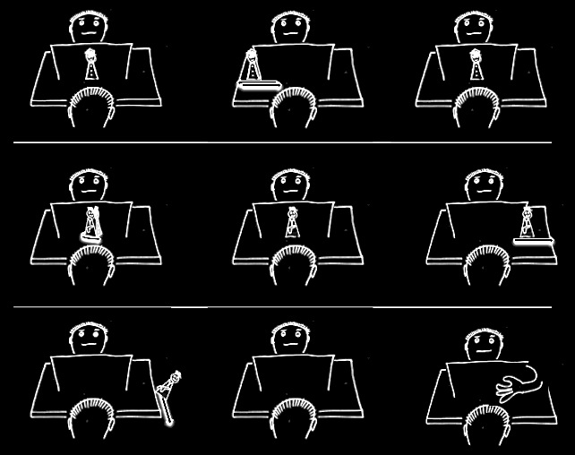

Slide 109
Notes:
Although this is my view and I stand by it, I don't think it resolves the puzzle all by itself.
The problem is this.
Success on many B-tasks is in principle possible using only a very simple measure for representing beliefs.
Further, B-tasks do not seem to differ from A-tasks with respect to which measures for representing beliefs could in principle explain success on these tasks.
So the view raises and does not answer the question of why children continue to systematically fail false belief B-tasks years after they can pass A-tasks.

Slide 110
1. There are subjects who can pass A-tasks but cannot pass B-tasks.
2. These subjects’ success on A-tasks is explained by the fact that they can represent (false) beliefs
3. These subjects’ failure on B-tasks is explained by the fact that they cannot represent (false) beliefs
Notes:
Nati asked whether there’s a way to predict that something will be an A-task or a B-task.
In a paper to appear in Psychological Science called ‘How to pass the false-belief task before your 4th birthday’, Rubio and Geurts note that existing discussions of this puzzle do not provide “a proper analysis of the tasks as such”.
They offer a simple proposal.
In A-tasks, children’s perspective tracking is not disrupted. For example, they are not asked a WH-question; the visual scene is not blanked or disrupted; and the protagonist moves in coherent ways.
In B-tasks, by contrast, there is a disruption in perspective tracking.
Rubio and Geurts test this proposal on three year olds. They show that they can pass a simple false belief task using an act-out paradigm (Duplo) when there is no perspective disruption, but that children’s performance is significantly worse when they are asked a WH-question (exp. 2A) or when the protagonist is made to disappear (exp 2B).
In work in progress, these authors also studied adults’ eye movements. They find that first looks are indicative of false-belief tracking, but only when the scene remains constant. If you blank the scene, first looks are no longer to the location where the protagonist left her object (I’m not sure there’s a pattern concerning where they do look).
So here is an intriguing possibility. Of course it raises a question: why does introducing certain kinds of disruption make the task so much harder? We know that there are multiple mechanisms for visual perspective taking, including mental self-rotation, object-rotation and reasoning it out. Each of these is suspeptible to different kinds of disruption. For example, if you are engaged in mental self-rotation and I remove the protagonist from the scene (or even have it change posture), this should be especially disruptive. It might turn out that there are multiple mechanisms for tracking mental state as well, and that some are more like mental self-rotation in that they involve imaginatively adopting another’s perspective whereas others are more like reasoning out what is on someone’s left or right.
But here I’m getting ahead. I think it’s too early to put a lot of weight on this idea. I mention it only because Nati asked whether there is a way of predicting whether a novel task will be an A-task or a B-task, and I think this is an key question that has so far be neglected.

Slide 111
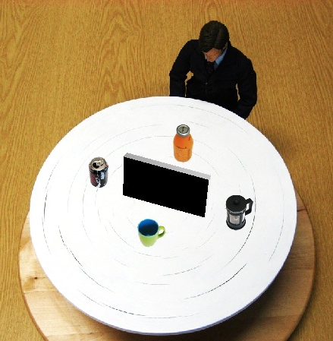
1. There are subjects who can pass A-tasks but cannot pass B-tasks.
2. These subjects’ success on A-tasks is explained by the fact that they can represent (false) beliefs
3. These subjects’ failure on B-tasks is explained by the fact that they cannot represent (false) beliefs
source: Kessler
Notes:
We know that there are multiple mechanisms for visual perspective taking, including mental self-rotation, object-rotation and reasoning it out. Each of these is suspeptible to different kinds of disruption. For example, if you are engaged in mental self-rotation and I remove the protagonist from the scene (or even have it change posture), this should be especially disruptive. It might turn out that there are multiple mechanisms for tracking mental state as well, and that some are more like mental self-rotation in that they involve imaginatively adopting another’s perspective whereas others are more like reasoning out what is on someone’s left or right.
But here I’m getting ahead. I think it’s too early to put a lot of weight on this idea. I mention it only because Nati asked whether there is a way of predicting whether a novel task will be an A-task or a B-task, and I think this is an key question that has so far be neglected.

